Slide 1
UAV-Based Post-Disaster 3D Scene Reconstruction For Efficient Survivor Detection
SECOND REVIEW
Abhishek Manoharan (2019503502)
Nishanthini S (2019503537)
Vamsi Raju M (2019503568)
Guided by: Dr. R. Gunasekaran

Slide 2
PROBLEM STATEMENT
Post-disaster scene understanding frameworks are becoming increasingly crucial in search and rescue operations and damage assessment initiatives. The use of Unmanned Aerial Vehicles (UAVs) provides an efficient method to complete the task of scene understanding.
However, complex environments present in post-disaster scenarios make it difficult for UAVs to detect humans or objects accurately. Moreover, inefficient object detection mechanisms lead to low accuracy and a long time for object detection tasks.
Hence, to mitigate these issues, we propose a UAV-based scene understanding scheme involving a GAN-aided 3D reconstruction mechanism.

Slide 3
PROBLEM STATEMENT
This approach deploys a Generative Adversarial Network (GAN)-based model to denoise and remove occlusion in the images obtained from the UAVs.
The framework classifies objects present in the visual scope of the UAV using a 3D reconstruction of the images obtained from the UAV, followed by semantic segmentation, resulting in pixel-level prediction and classification of entities present in the 3D model.
Furthermore, an ensemble network consisting of a combination of single-stage and multi-stage detectors is to be used to improve the performance of the survivor detection model. This will help reduce the false negative rate and improve the overall accuracy of the system.

Slide 4
LITERATURE SURVEY
S.No | Publication Venue and Year | Title | Proposed Work | Limitations
1. | IEEE Journal on Miniaturization for Air and Space Systems, vol. 2, no. 4, pp. 209-219 (2021) | UAV-Based Real-Time Survivor Detection System in Post-Disaster Search and Rescue Operations | This paper proposes a new thermal image dataset consisting of 6447 thermal images designed for survivor detection using UAVs in post-disaster scenarios. The paper also describes optimal values to prune survivor detection models in order to reduce the complexity of the models. The model applies knowledge distillation techniques to fine-tune them and improve accuracy. The performance of several survivor detection models based on YOLOv3 and YOLOv3-MobileNetV1 were compared with and without pruning and fine-tuning. | Older and inferior detection models have been used for survivor detection, thereby resulting in models with high mean average precision (mAP) loss and low accuracy.

Slide 5
LITERATURE SURVEY
S.No | Publication Venue and Year | Title | Proposed Work | Limitations
2. | IEEE Transactions on Geoscience and Remote Sensing, vol. 60, pp. 1-16 (2022) | Swarm UAV SAR for 3-D Imaging | This paper implements a 3D imaging mechanism for 2D images obtained from a swarm of UAVs. The proposed work involves the 3D imaging of a scene by the usage of 2D images obtained from several UAVs present in the UAV Swarm at different perspectives with a few points of overlap. The point cloud obtained is then triangulated, and Bundle Adjustment is used to create the 3D rendering of the image. | A considerable amount of data must be transmitted from the UAV swarm, as images obtained from each node in the swarm are used to produce the 3D rendering. Multiple UAVs also need to exchange information in order to efficiently collect data of the scenario.

Slide 6
LITERATURE SURVEY
S.No | Publication Venue and Year | Title | Proposed Work | Limitations
3. | IEEE Transactions on Geoscience and Remote Sensing, vol. 57, no. 11, pp. 8879-8889 (2019) | Method for 3-D Scene Reconstruction Using Fused LiDAR and Imagery From a Texel Camera | In order to create greater fidelity terrain models, this study describes a bundle adjustment technique for aerial texel images. The model enables relatively low-accuracy navigation systems to be employed with inexpensive LiDAR and camera data. | Outliers present in the point cloud are not identified and mitigated, thereby leading to lower accuracy.

Slide 7
LITERATURE SURVEY
S.No | Publication Venue and Year | Title | Proposed Work | Limitations
4. | 25th IEEE International Conference on Pattern Recognition (ICPR), pp. 10227-10234 (2021) | SyNet: An ensemble network for object detection in UAV images | With the goal of lowering the high false negative rate of multi-stage detectors and improving the quality of the single-stage detector proposals, the authors of this research propose an ensemble network called SyNet that combines a multi-stage method with a single-stage one. | According to the investigation, detecting objects in drone images is more challenging than detecting them in images that were taken from the ground, even with the most advanced object detection algorithms. Hence, the accuracy of the model trained on UAV images is still low compared to models trained on ground images.

Slide 8
LITERATURE SURVEY
S.No | Publication Venue and Year | Title | Proposed Work | Limitations
5. | IEEE Transactions on Neural Networks and Learning Systems, vol. 33, no. 11, pp. 6047-6067 (2022) | Vehicle Detection From UAV Imagery With Deep Learning | The article provides a review of vehicle detection from UAV imagery using deep learning techniques. It begins by outlining the various deep learning architectures, including generative adversarial networks autoencoders recurrent neural networks convolutional neural networks and their contributions to the challenge of improving vehicle detection. The paper then focuses on examining various vehicle detection techniques and presents different benchmark datasets and problems that have been discovered, along with possible remedies. | Videos captured in the UAVs are sent to on-ground workstations or to the cloud for processing rather than being implemented on the UAV itself, thereby leading to the absence of a lightweight system for vehicle detection

Slide 9
LITERATURE SURVEY
S.No | Publication Venue and Year | Title | Proposed Work | Limitations
6. | IEEE Transactions on Instrumentation and Measurement, vol. 71, pp. 1-13 (2022) | Dense and Small Object Detection in UAV-Vision Based on a Global-Local Feature Enhanced Network | This paper proposes a global-local feature-enhanced network (GLF-Net) to alleviate issues when detecting small and dense objects using UAVs. A feature-fusion module has been proposed to tackle the presence of numerous small objects. GLF-Net achieves 86.52% mean Average Precision (mAP) on the RO-UAV dataset. | The scalability of the framework is poor, and the application of GLF-Net on post-disaster UAV images leads to lower mAP, thereby requiring better frameworks.

Slide 10
LITERATURE SURVEY
S.No | Publication Venue and Year | Title | Proposed Work | Limitations
7. | IEEE/CVF International Conference on Computer Vision (ICCV), pp. 1223-1232 (2021) | Unmanned aerial vehicle visual detection and tracking using deep neural networks: A performance benchmark | This paper executes and compares various UAV detection mechanisms using air-borne UAVs that deploy deep neural networks. 4 datasets have been used and performance has been compared, namely MAV-VID, Drone-vs-Bird, Anti-UAV RGB, and Anti-UAV IR. The performance of 4 models was compared using the datasets mentioned, namely Faster RCNN, SSD512, YOLOv3, and DETR (Detection Transformer). Overall, Faster RCNN performed best. | Long-distance detection of small UAVs was not taken into consideration. Deep neural networks for re-identification of UAVs were not considered as well.

Slide 11
LITERATURE SURVEY
S.No | Publication Venue and Year | Title | Proposed Work | Limitations
8. | UMBC Student Collection (2021) | RescueNet: A High-Resolution Post Disaster UAV Dataset for Semantic Segmentation | This paper introduces a high-resolution post-disaster UAV dataset named RescueNet, which contains comprehensive pixel-level annotation of 11 classes for semantic segmentation to assess damage after a natural disaster. The dataset collection and annotation process are discussed, along with the challenges it poses. | RescueNet contains a small number of classes. As a result, smaller objects like “vehicles” and “pools” make it difficult to get a good segmentation compared to larger objects like buildings and roads. Besides that, since UAV images include only the top view of a scene, it is difficult to assess the actual damage since the horizontal view also brings information regarding all sides of a building.

Slide 12
LITERATURE SURVEY
S.No | Publication Venue and Year | Title | Proposed Work | Limitations
9. | IEEE/CVF Conference on Computer Vision and Pattern Recognition (CVPR), pp. 16266-16275 (2021) | Uav-human: A large benchmark for human behavior understanding with unmanned aerial vehicles | This paper proposes a UAV-Human dataset for human action, pose, and behavior understanding. The proposed UAV-Human contains 67,428 multi-modal video sequences 119 subjects for action recognition 22,476 frames for pose estimation 41,290 frames 1,144 identities for person re-identification 22,263 frames for attribute recognition which encourages the exploration and deployment of various data-intensive learning models for UAV-based human behavior understanding. | The UAV-Human dataset poses a limitation for attribute recognition because the dataset is captured over a relatively long period of time. As a result, the subjects have been diversified with different dressing types and large variations of viewpoints caused by multiple UAV altitudes.

Slide 13
LITERATURE SURVEY
S.No | Publication Venue and Year | Title | Proposed Work | Limitations
10. | 2021 IEEE International Geoscience and Remote Sensing Symposium IGARSS, pp. 2325-2328 (2021) | Attention-Based Semantic Segmentation on UAV Dataset for Natural Disaster Damage Assessment | This paper proposes and evaluates a novel self-attention segmentation model named ReDNet on a new high-resolution UAV natural disaster dataset named HRUD. The challenges of semantic segmentation on the HRUD dataset are discussed, along with the excellent performance of the proposed model. | HRUD is a very challenging dataset due to its variable-sized classes along with similar textures among different classes. Debris, textures of debris, sand, and building with destruction damage make a great impact on the segmentation performance of the evaluated network models.

Slide 14
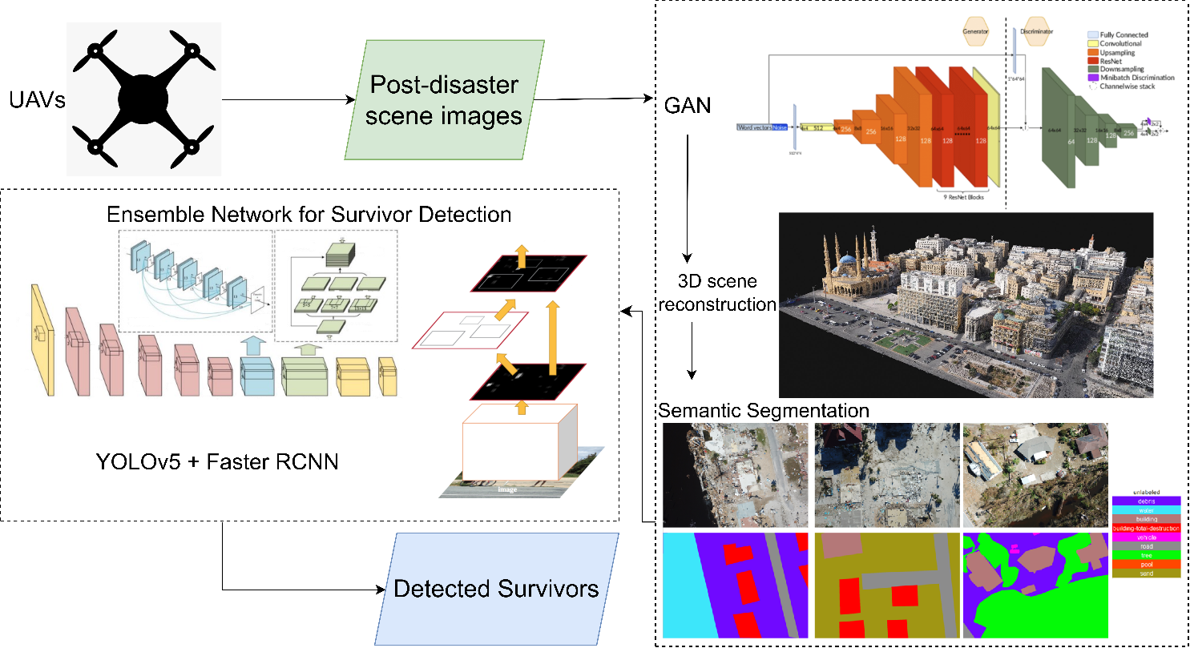
SYSTEM ARCHITECTURE

Slide 15
NOVELTY
A GAN denoiser results in images having lower occlusion and optimal brightness, thereby highlighting the important features of the object. Furthermore, using GAN improves the detection of small and dense objects, which is the case of survivors in images obtained from a UAV.
A 3D reconstruction of the scene using the enhanced images obtained from the GAN-based model will be used to map and extract useful information from the scene.
The GAN-based 3D reconstruction framework incorporating the Structure-From-Motion (SFM) and bundle adjustment algorithms enhances occluded survivors in the 3D model, thereby resulting in a more efficient survivor detection mechanism compared to existing frameworks.

Slide 16
NOVELTY
Semantic segmentation on the 3D model leads to a pixel-level prediction of various entities or objects present in the image.
The ensemble model, a hybrid architecture consisting of single-stage and multi-stage detectors, overcomes the disadvantages of both frameworks.
Deploying an ensemble network comprising the YOLOv5 and Faster R-CNN frameworks improves the performance and efficiency of survivor detection.
The overall framework will increase the accuracy and performance of the survivor detection task, thereby resulting in efficient Search-And-Rescue operations.

Slide 17
EXPECTED OUTCOMES
To develop an efficient post-disaster scene understanding framework using UAVs for survivor detection and Search-And-Rescue (SAR) operations.
To deploy a Generative Adversarial Network (GAN) framework to improve the detection of survivors, who are generally present as small and dense objects in post-disaster UAV images. A GAN denoiser will result in images having lower occlusion and optimal brightness, thereby highlighting the important features of the object.
To devise a 3D scene-reconstruction mechanism based on the Structure-From-Motion (SFM) and bundle adjustment algorithms using images obtained from a swarm of UAVs to map and extract useful information from the scene.

Slide 18
EXPECTED OUTCOMES
To deploy a semantic segmentation mechanism on the 3D model, leading to a pixel-level prediction of various entities or objects in the 3D model. This will improve the detection of survivors present in the post-disaster scene.
To implement a hybrid single-stage and multi-stage ensemble network for survivor detection on the previously obtained semantic entities. The model will comprise the YOLOv5 and Faster R-CNN mechanisms to combine the benefits of both, thereby decreasing the high false negative rate of multi-stage mechanisms and improving the performance of single-stage detectors.

Slide 19
MODULES IDENTIFIED
Module 1: Ensemble Model
Hybrid single-stage (YOLOv5) and multi-stage (Faster RCNN) survivor detection model for efficient Search-And-Rescue operations.
Module 2: Semantic Segmentation
Semantic segmentation mechanism for pixel-level prediction and entity classification.
Module 3: GAN-infused 3D reconstruction mechanism
GAN-based denoiser and occlusion removal mechanism for better survivor detection from UAV images. 3D scene reconstruction framework that creates a 3D model based on the enhanced images obtained from the GAN mechanism, incorporating the Structure-From-Motion (SFM) and bundle adjustment algorithms.

Slide 20
Overall Performance Evaluation Approach
Three model execution pipelines will be implemented and compared for performance, namely:
Regular 2D images passed through an Ensemble network comprising single-stage and multi-stage networks for survivor detection
Regular 2D images pre-processed through the Semantic Segmentation module, followed by the Ensemble network-based survivor detection model.
2D images passed through a GAN-infused 3D reconstruction mechanism to obtain a 3D model of the post-disaster scene, upon which semantic segmentation is executed. The Ensemble network-based survivor detection model will be implemented on the output obtained from the previous step.

Slide 21
algorithms
Algorithm 1: Object Detection using a hybrid Single-Stage and Multi-Stage Ensemble Model
Input:
single_stage_model: A PyTorch model trained with a single-stage detector architecture.
multi_stage_model: A PyTorch model trained with a multi-stage detector architecture.
images: A list of images to detect objects in.
conf_threshold: A confidence threshold below which predictions are suppressed.
iou_threshold: An IoU threshold above which overlapping predictions are suppressed.
Output:
results: A list of dictionaries containing the detection results for each image.
Procedure:
Initialize an empty list of results.
For each image in images, do the following:
Use the single-stage model to detect objects in the image and store the detection results in a list ‘single_stage_results’.
Use the multi-stage model to detect objects in the image and store the detection results in a list ‘multi_stage_results’.
Concatenate the detection results from the single-stage and multi-stage models into a single tensor.
Apply non-maximum suppression to the tensor with confidence threshold conf_threshold and IoU threshold iou_threshold.
Convert the detection results to a dictionary format with keys 'boxes', 'scores', and 'labels', and append the dictionary to results.
Return the results list.

Slide 22
algorithms
Algorithm 2: Semantic Segmentation
Input:
model: A PyTorch model trained for semantic segmentation.
images: A list of images to perform segmentation on.
batch_size: An integer specifying the batch size for inference.
Output:
results: A list of dictionaries containing the segmentation results for each image.
Procedure:
Initialize an empty list results.
For each batch of size batch_size in images, do the following:
Preprocess the images by normalizing and converting them to tensors.
Feed the batch of images to the model and obtain the segmentation results.
Convert the segmentation results to a dictionary format with keys 'mask' and 'class', and append the dictionary to results.
Return the results list.

Slide 23
algorithms
Algorithm 3: GAN-based Occlusion Remover
Input:
generator: A PyTorch generator model trained to remove occlusions.
images: A list of images with occlusions.
batch_size: An integer specifying the batch size for inference.
Output:
results: A list of images with occlusions removed.
Procedure:
Initialize an empty list of results.
For each batch of size batch_size in images, do the following:
Preprocess the images by resizing, normalizing and converting them to tensors.
Feed the batch of images to the generator and obtain the occlusion-removed images.
Convert the occlusion-removed images back to numpy arrays and append them to results.
Return the results list.
Preprocessing:
Resize the input images to the required size for the generator model.
Normalize the pixel values of the images to be in the range [-1, 1].
Convert the images to tensors.
Occlusion Removal:
Feed the pre-processed batch of images to the generator model.
The generator model generates occlusion-free versions of the input images.
Convert the generated occlusion-free images back to numpy arrays.

Slide 24
algorithms
Algorithm 4: 3D Reconstruction of 2D Images using Structure-From-Motion
Input:
images: A set of 2D images of an object from different views.
camera_params: The camera parameters used to capture the images.
matching_threshold: The threshold for feature matching.
reconstruction_threshold: The threshold for 3D point reconstruction.
bundle_adjustment_iterations: The number of iterations for bundle adjustment.
Output:
point_cloud: A 3D point cloud of the object.
Procedure:
Extract feature points from each image using a feature detector (SIFT).
Match the feature points between image pairs using a feature descriptor (ORB) and a matching algorithm (FLANN).
Estimate the fundamental matrix for each image pair using the matched feature points.
Estimate the essential matrix for each image pair using the camera parameters and the fundamental matrix.
Compute the relative camera poses (i.e., rotation and translation) for each image pair using the essential matrix and the camera parameters.
Triangulate the 3D points using the relative camera poses and the matched feature points.
Perform bundle adjustment to refine the camera poses and the 3D points using all images and their matched feature points.
Filter the 3D points based on the reconstruction threshold to remove outliers.
Return the 3D point cloud.

Slide 25
algorithms
Algorithm 4: 3D Reconstruction of 2D Images using Structure-From-Motion (cont…)
Feature Detection and Matching:
Feature detection is the process of identifying distinctive image features, such as corners or blobs, that can be matched between images.
Feature matching is the process of finding corresponding feature points between image pairs.
Fundamental Matrix and Essential Matrix:
The fundamental matrix describes the geometric relationship between two views of a scene, given the corresponding image points.
The essential matrix relates the camera poses between two views of a scene, given the intrinsic camera parameters and the fundamental matrix.
Triangulation:
Triangulation is the process of computing the 3D position of a point in space, given its projections onto multiple images and the camera poses.
Bundle Adjustment:
Bundle adjustment is a nonlinear optimization algorithm that jointly refines the camera poses and the 3D points to minimize the reprojection error.

Slide 26
implementation
Ensemble Model:
An ensemble model comprising the YOLOv5 single-stage detector and the Faster RCNN multi-stage detector was implemented.
The main advantage of the proposed combination of single-stage and multi-stage detectors is the improved object detection performance over an independent single-stage detector and lower false negative rate than an independent multi-stage detector.
Our choice of CNN mechanisms: YOLOv5, being one of the most popular and powerful single-shot detectors, is a stable version of the ‘You Only Look Once’ family of CNN-based object detection models. Faster RCNN is a very powerful two-stage detector that is widely used for object detection mechanisms.

Slide 27
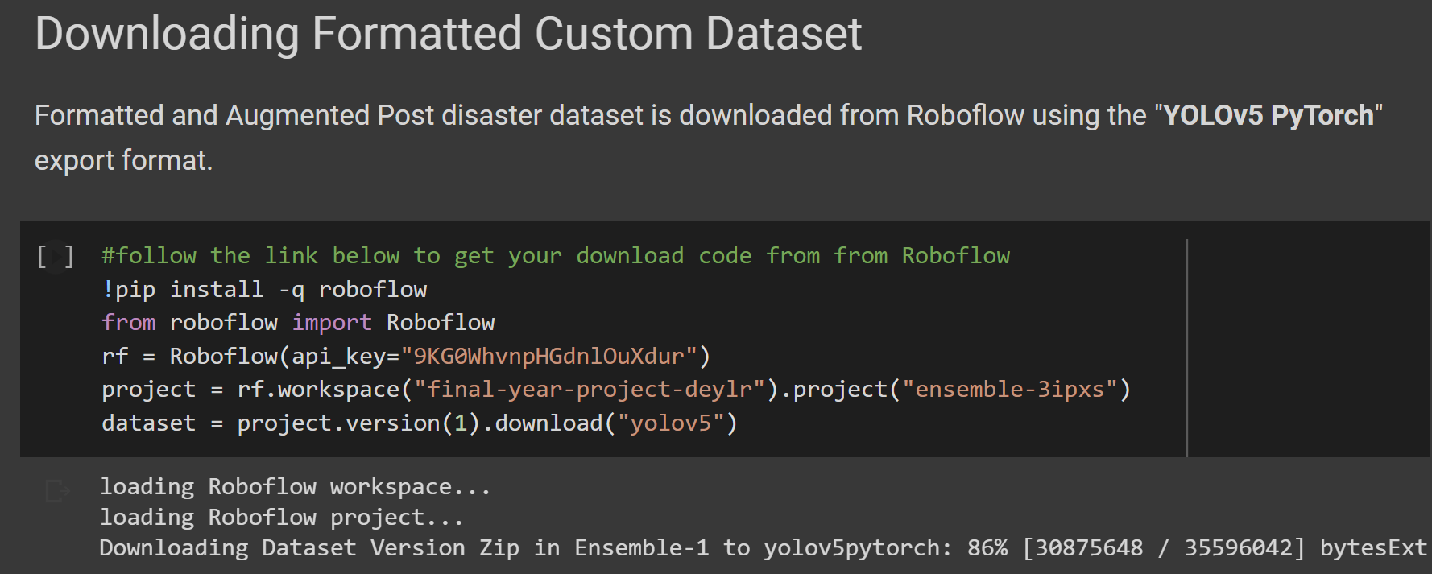
implementation
YOLOv5:
The YOLOv5 model is instantiated by downloading all dependencies from the official ‘ultralytics’ github repository.
Our dataset of choice, namely RescueNet, is annotated and augmented using the Roboflow software.
Additional pre-processing techniques are incorporated within the Roboflow workspace, and a unique api key is generated for our dataset.
This api key is then used to download the dataset and the respective annotations in PyTorch YOLOv5 format.

Slide 28
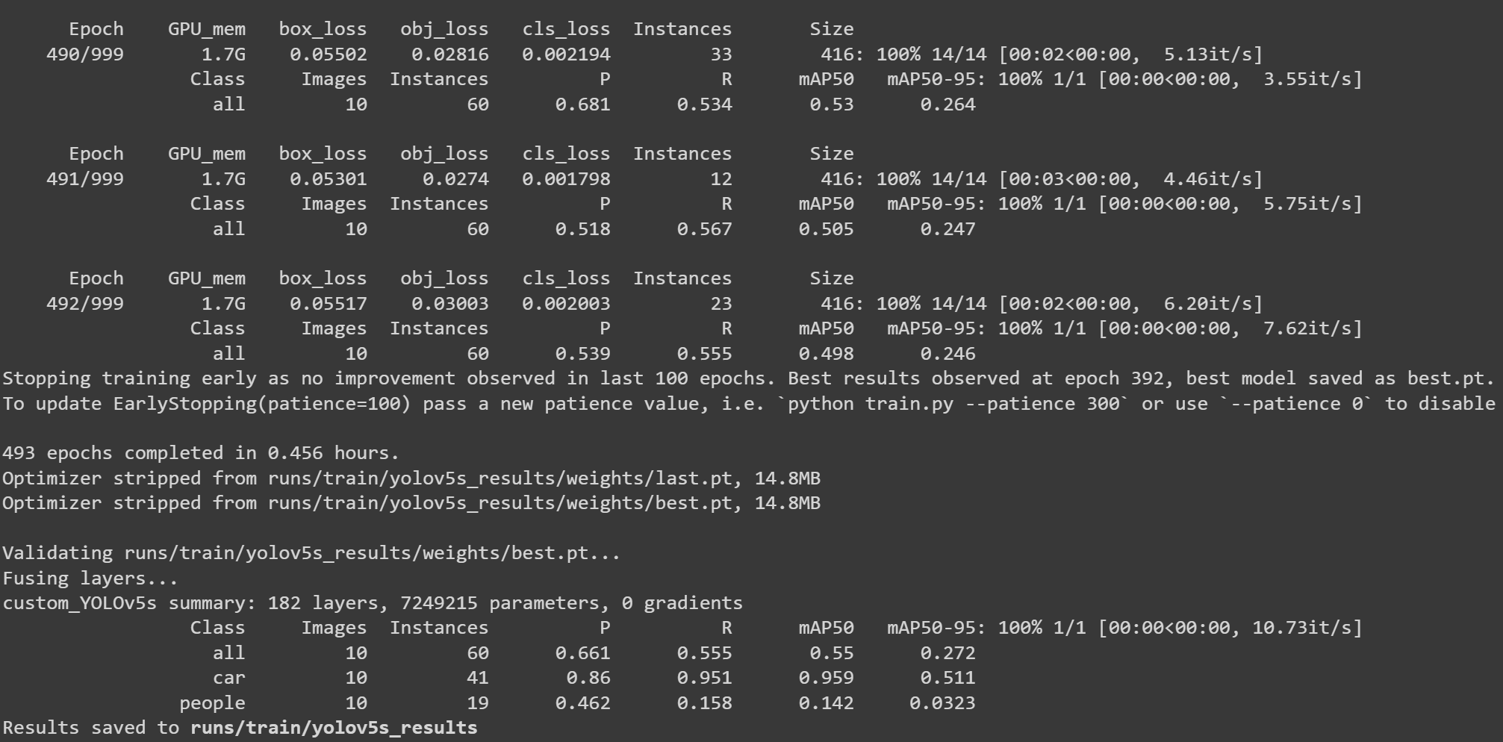
implementation
The YOLOv5 model is then trained with batch size 16 for 492 epochs. The configurations previously defined in custom_yolov5s.yaml are also given as input parameters.
In our case, Early stopping was observed as the model performance did not vary over a period of epochs, thereby stopping the training process in the 492nd epoch.
The Mean Average Precision (mAP) is calculated for every epoch/iteration and displayed in the output.
Finally, the total number of instances that the model visualized under each class is tabulated and presented, and the weights are stored in the yolov5s_results folder as ‘best.pt’.

Slide 29
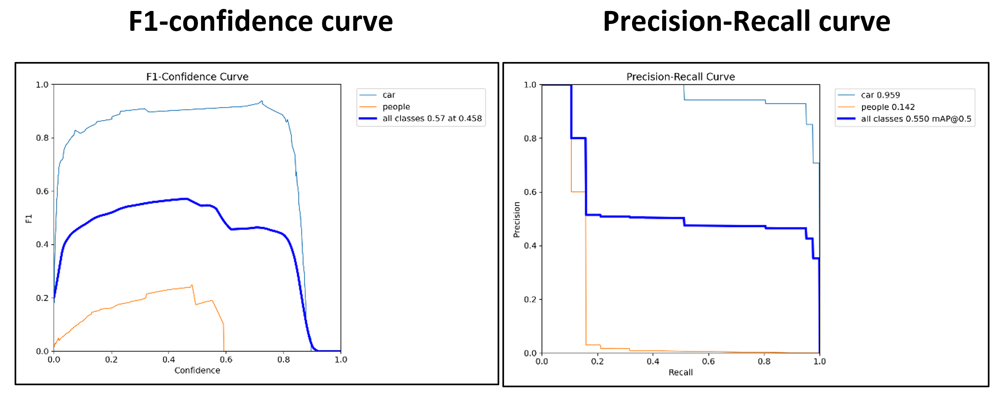
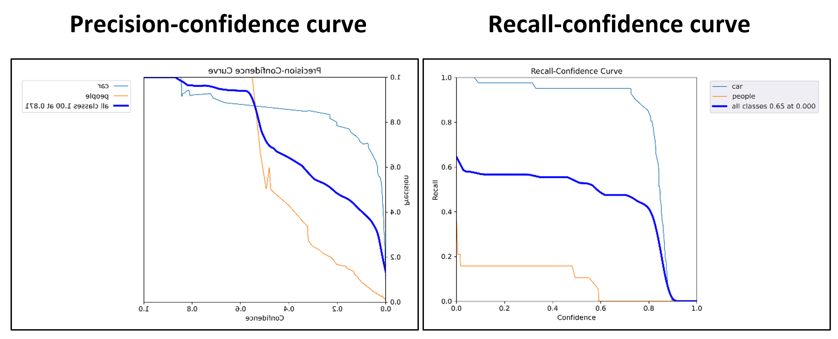
implementation
Tensorboard is then made use of to visualize the performance of the model.
Tesnorboard plots all performance metrics observed while training the model over the range of epochs for which the model was trained.
The overall training loss of the model was found to be 0.002 for identifying various classes.
The mean average precision (mAP) of the model after 492 epochs as found to be 0.55.

Slide 30
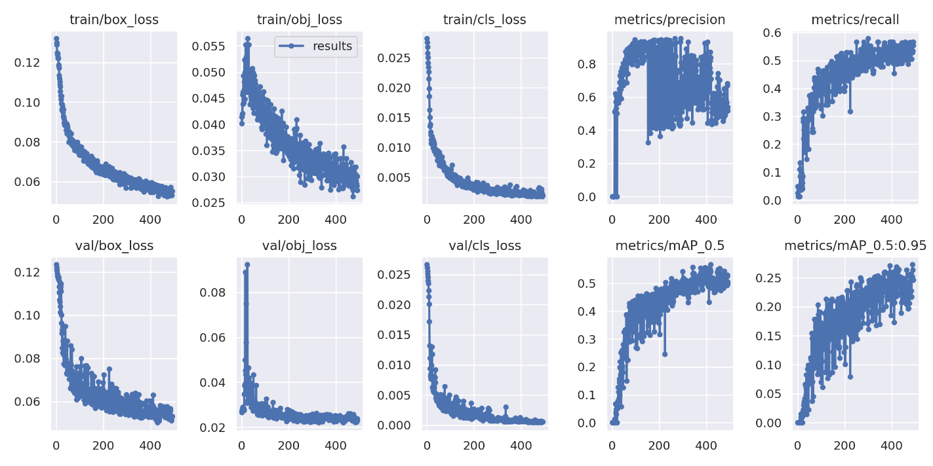
implementation
Performance Metrics

Slide 31
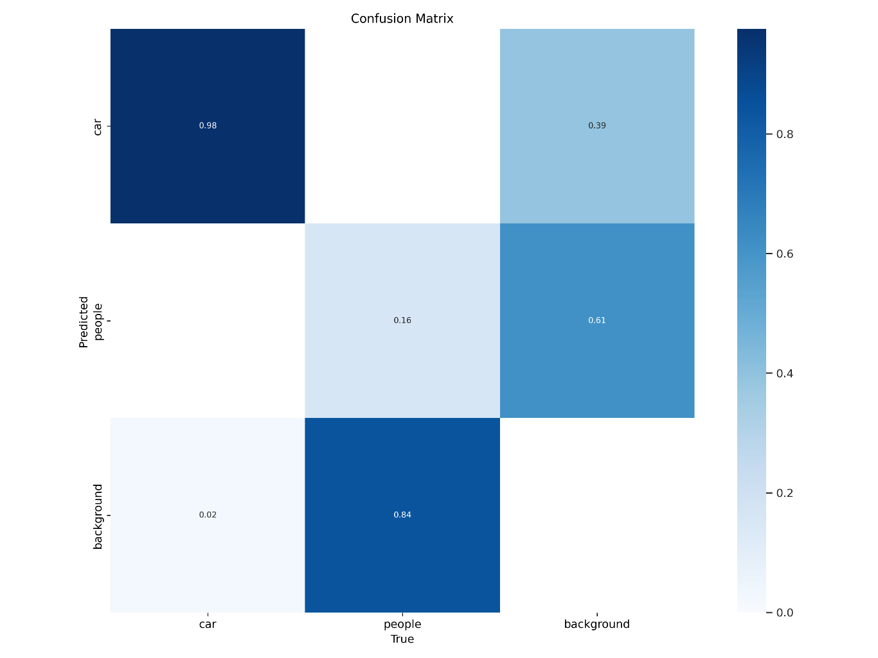
implementation
Confusion Matrix

Slide 32
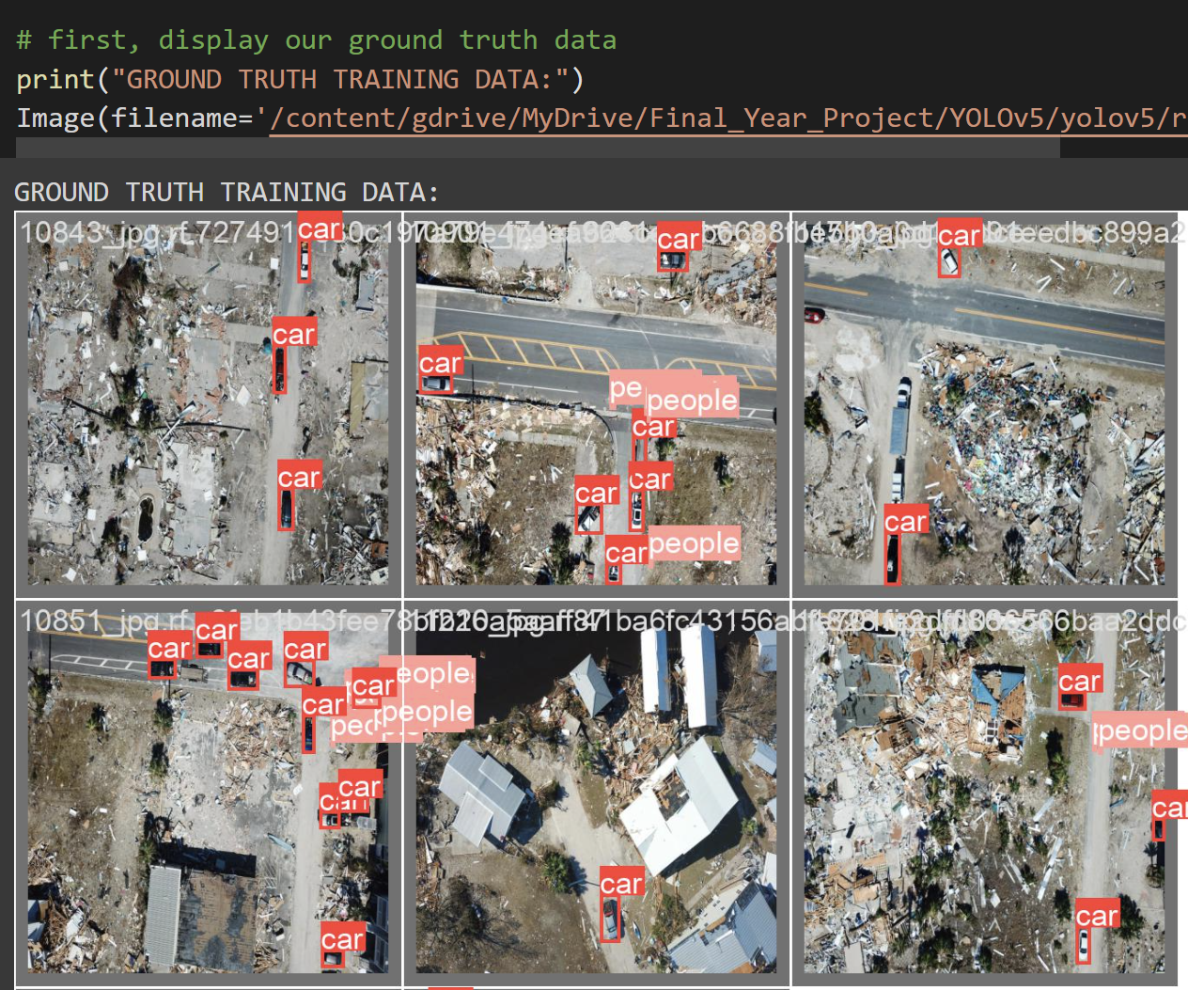
implementation
The trained model is then tested by visualizing results obtained when test images are passed through the model.
The bounding boxes constructed over detected classes are displayed.

Slide 33
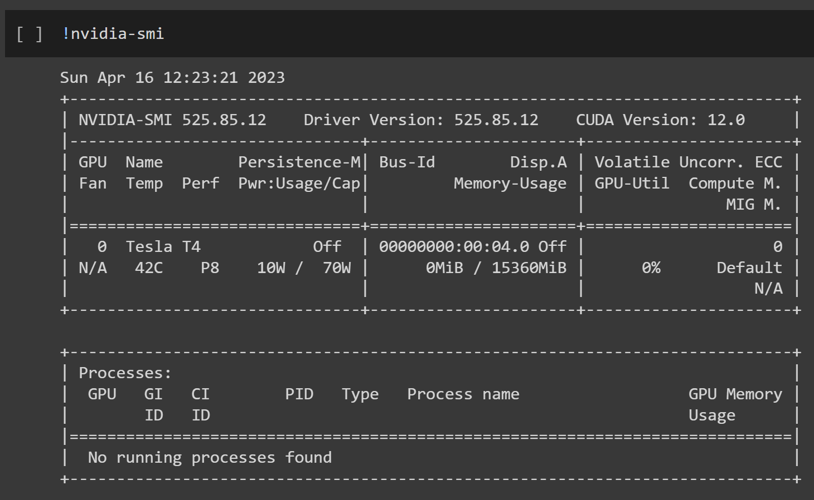
implementation
Faster RCNN:
The Faster RCNN multi-stage CNN model is implemented using Detectron2, which is a computer vision library that allows the implementation of various CNN models through the usage of PyTorch.
Initially, the GPU instantiated in the Google Colab environment is displayed using the nvidia-smi command.

Slide 34
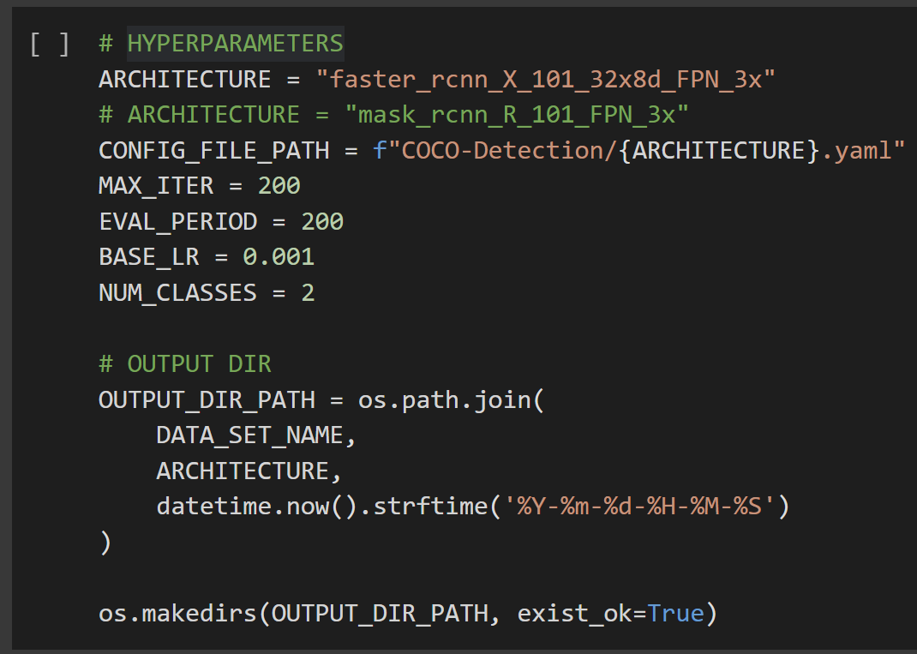
implementation
Faster RCNN:
The Faster RCNN multi-stage CNN model is implemented using Detectron2, which is a computer vision library that allows the implementation of various CNN models through the usage of PyTorch.
Initially, the GPU instantiated in the Google Colab environment is displayed using the nvidia-smi command.
The Faster RCNN model is then instantiated and trained using the faster_rcnn_X_101_32x8d_FPN_3x architecture present in Detectron2. Other parameters required for training the model are defined as well.

Slide 35
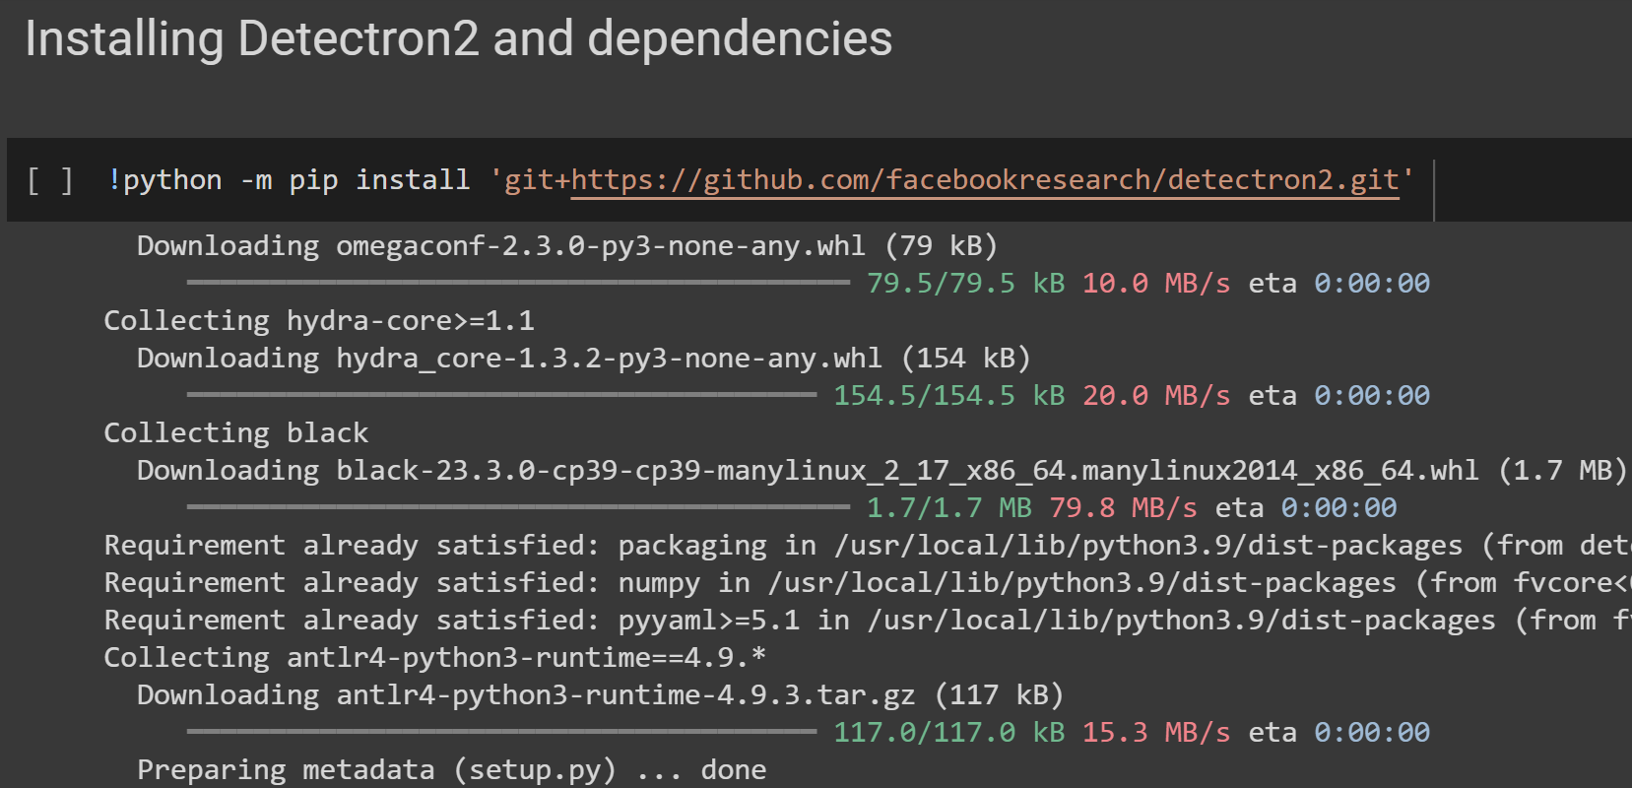
implementation
The dependencies of Detectron2 are installed to be able to setup Detectron2 and Faster RCNN.
The versions of all dependencies are confirmed.

Slide 36
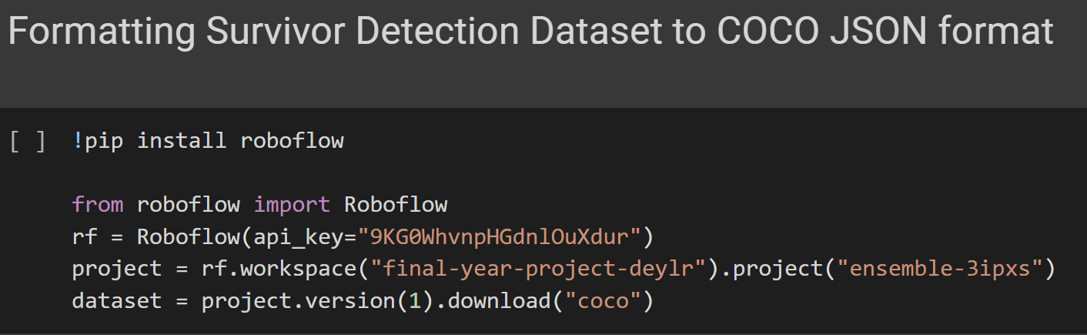
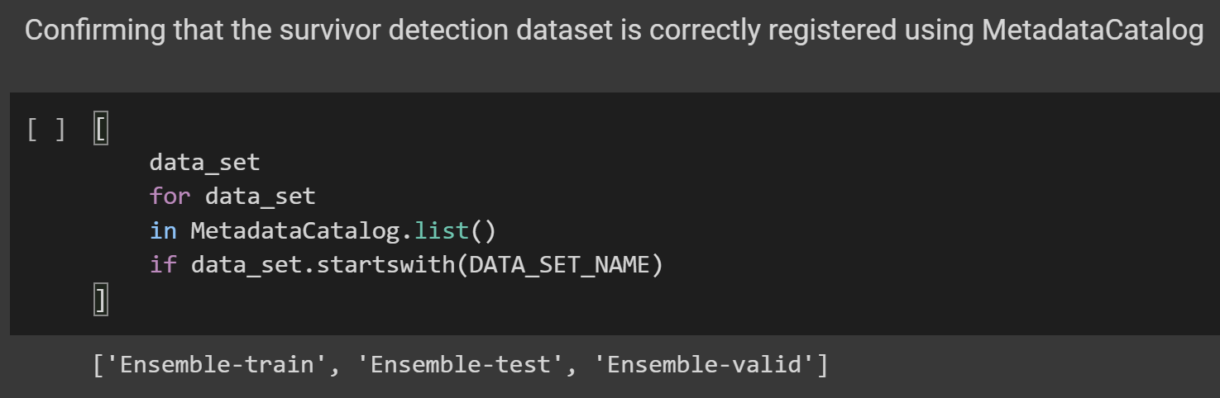
implementation
The dataset previously annotated and augmented on Roboflow is downloaded along with annotations in the COCO JSON format. Roboflow being a versatile software allows exporting various annotation formats for the same dataset.
The COCO JSON format is used while training a Faster RCNN model.
The dataset is then registered to detectron2 to be able to use the dataset for training the Faster RCNN model.

Slide 37
implementation
The Faster RCNN model is then instantiated and trained using the faster_rcnn_X_101_32x8d_FPN_3x architecture present in Detectron2.
Other parameters required for training the model are defined as well.

Slide 38
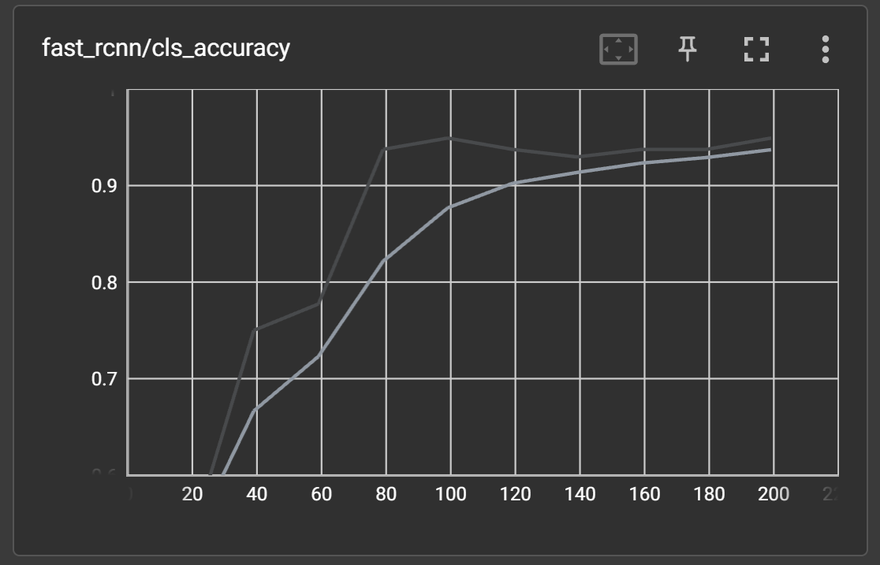
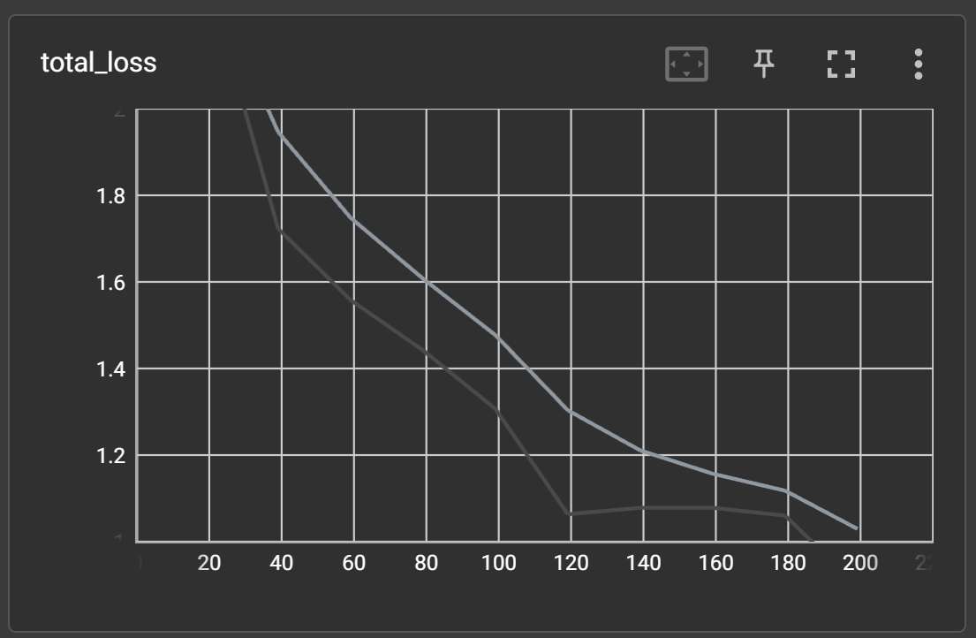
implementation
Once the model is trained, Tesnorboard is initialized, thereby giving various performance metrics observed during the training process of the Faster RCNN model.
Total loss of the model was observed to be 0.89. The accuracy of detecting various classes was found to be 93.75%.

Slide 39
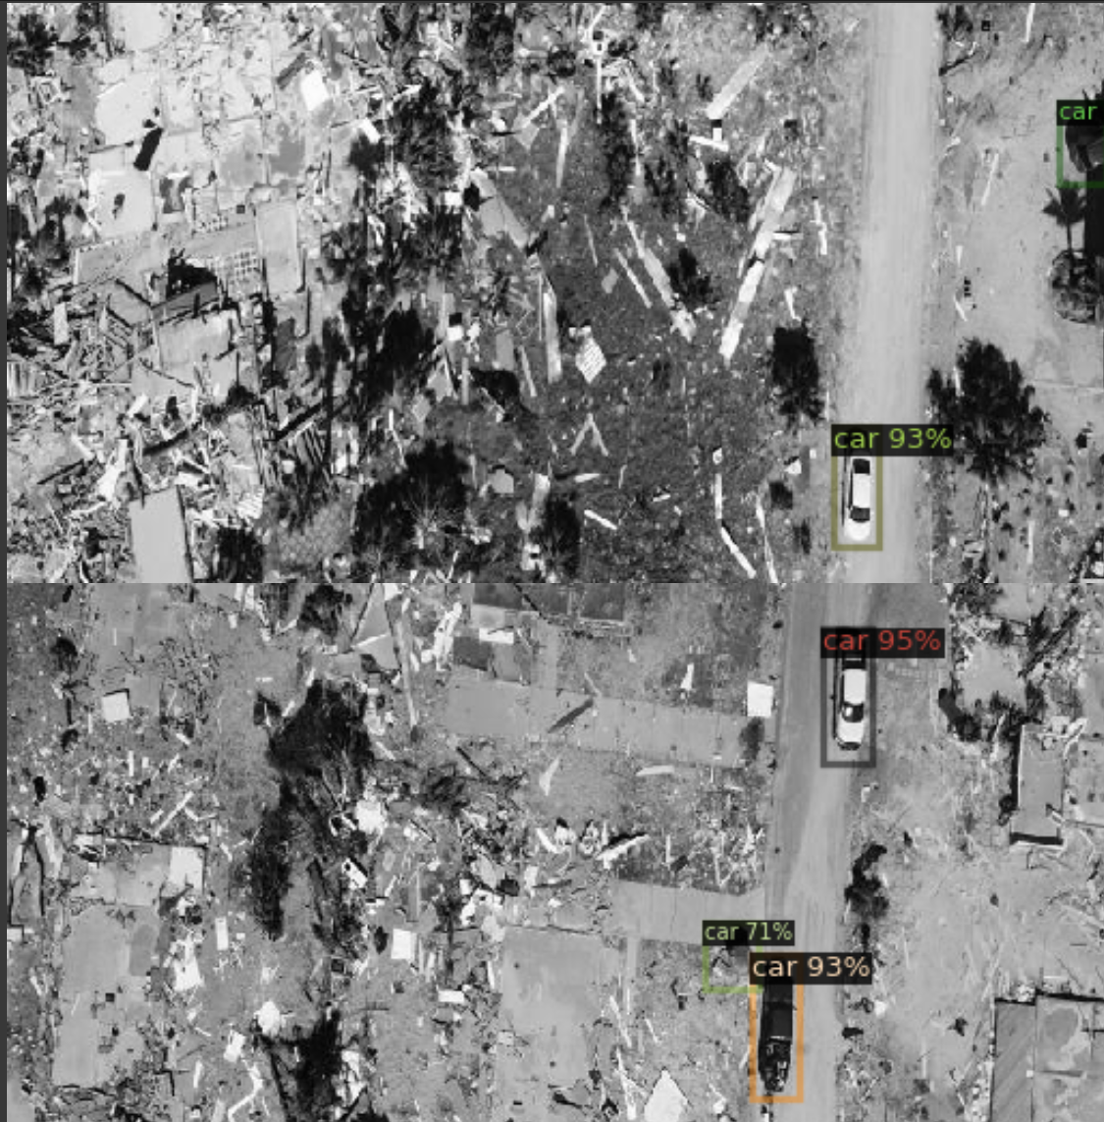
implementation
The trained model is then tested using the test set and results are visualized.
The model and its corresponding weights are then saved and stored in the ‘Saved_Models’ folder.

Slide 40
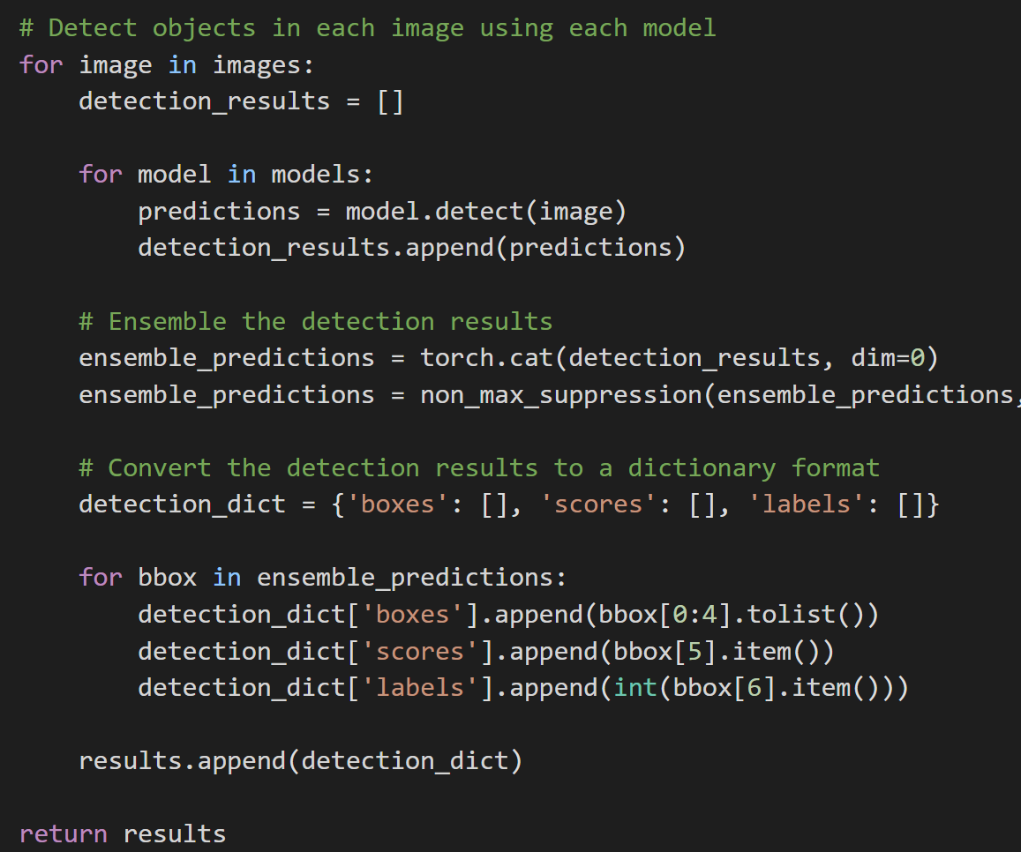
implementation
Final Ensemble Model combining both the trained models:
The final ensemble model is created using the two trained models obtained in the previous steps.
Both the models are executed for the same image and their respective outputs are visualized.
The models are then combined using the ensembling technique named ‘simple averaging’, wherein multiple models are trained independently and their predictions are combined to improve overall performance.

Slide 41
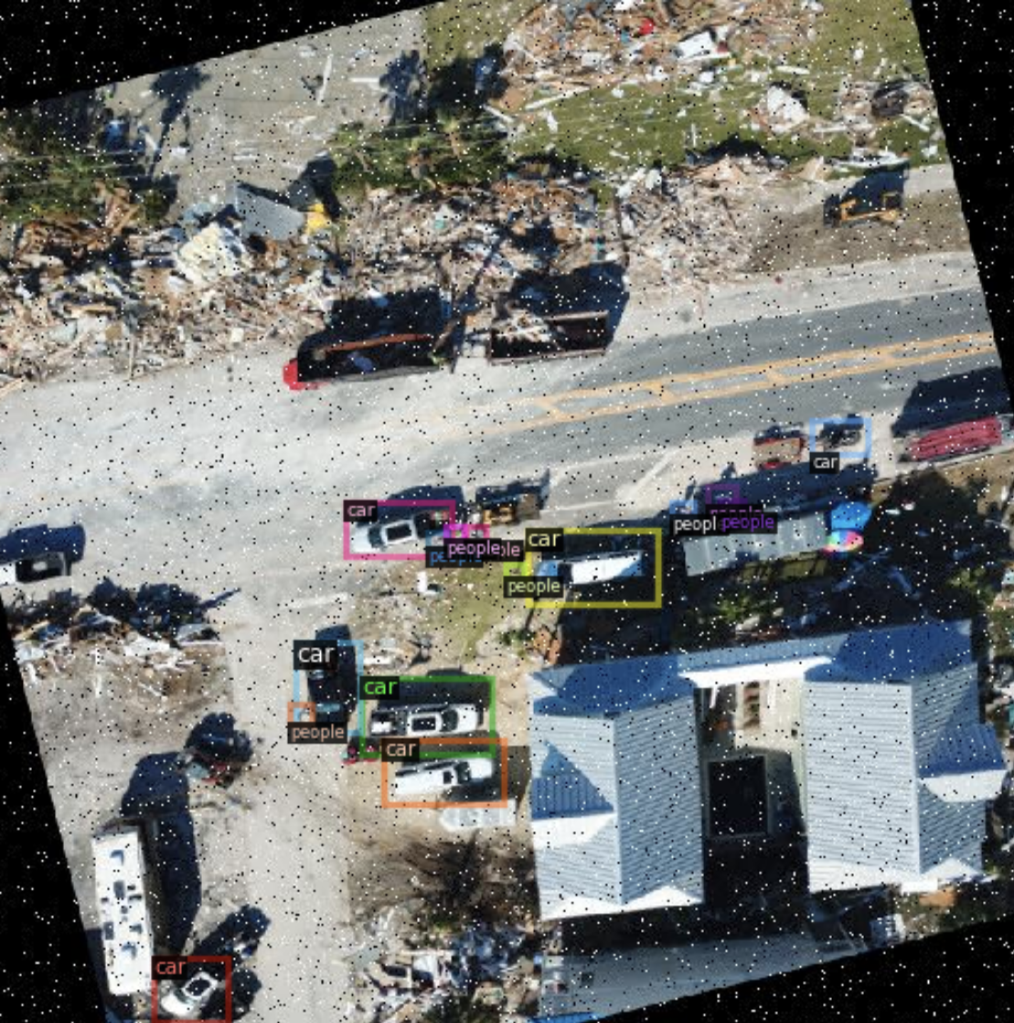
implementation
The ensembled model is then evaluated using the same image used for the previous models and the outputs are compared.

Slide 42
REFERENCES
J. Dong, K. Ota and M. Dong, "UAV-Based Real-Time Survivor Detection System in Post-Disaster Search and Rescue Operations" in IEEE Journal on Miniaturization for Air and Space Systems, vol. 2, no. 4, pp. 209-219, 2021
H. Ren et al., "Swarm UAV SAR for 3-D Imaging: System Analysis and Sensing Matrix Design" in IEEE Transactions on Geoscience and Remote Sensing, vol. 60, pp. 1-16, 2022
T. C. Bybee and S. E. Budge, "Method for 3-D Scene Reconstruction Using Fused LiDAR and Imagery From a Texel Camera" in IEEE Transactions on Geoscience and Remote Sensing, vol. 57, no. 11, pp. 8879-8889, Nov. 2019
Albaba, Berat Mert, and Sedat Ozer, "SyNet: An ensemble network for object detection in UAV images" in 25th IEEE International Conference on Pattern Recognition (ICPR), pp. 10227-10234, 2021
A. Bouguettaya, H. Zarzour, A. Kechida and A. M. Taberkit, "Vehicle Detection From UAV Imagery With Deep Learning: A Review" in IEEE Transactions on Neural Networks and Learning Systems, vol. 33, no. 11, pp. 6047-6067, Nov. 2022

Slide 43
REFERENCES
T. Ye, W. Qin, Y. Li, S. Wang, J. Zhang and Z. Zhao, "Dense and Small Object Detection in UAV-Vision Based on a Global-Local Feature Enhanced Network," in IEEE Transactions on Instrumentation and Measurement, vol. 71, pp. 1-13, 2022
Isaac-Medina, Brian KS, Matt Poyser, Daniel Organisciak, Chris G. Willcocks, Toby P. Breckon, and Hubert PH Shum. "Unmanned aerial vehicle visual detection and tracking using deep neural networks: A performance benchmark" In Proceedings of the IEEE/CVF International Conference on Computer Vision (ICCV), pp. 1223-1232, 2021.
Rahnemoonfar, Maryam, Tashnim Chowdhury, and Robin Murphy. "RescueNet: A High-Resolution Post Disaster UAV Dataset for Semantic Segmentation." UMBC Student Collection, 2021
Li, Tianjiao, Jun Liu, Wei Zhang, Yun Ni, Wenqian Wang, and Zhiheng Li. "Uav-human: A large benchmark for human behavior understanding with unmanned aerial vehicles" In Proceedings of the IEEE/CVF Conference on Computer Vision and Pattern Recognition (CVPR), pp. 16266-16275, 2021
T. Chowdhury and M. Rahnemoonfar, "Attention Based Semantic Segmentation on UAV Dataset for Natural Disaster Damage Assessment" 2021 IEEE International Geoscience and Remote Sensing Symposium IGARSS, pp. 2325-2328, 2021

Slide 44
THANK YOU

